Slide 1
Chapter 1: Introduction
(OS Structure, Modes and Services)

Slide 2
Kernel
A kernel is a central component of an operating system.
The sole aim of the kernel is to manage the communication between the software (user level applications) and the hardware (CPU, disk memory etc).
The main tasks of the kernel are :
  Process management
  Device management
  Memory management
  Interrupt handling
  I/O communication
  File system...etc..

Slide 3
Kernel
A kernel is the lowest level of software that interfaces with the hardware in your computer.
It is responsible for interfacing all applications that are running in “user mode” down to the physical hardware, and allowing processes, to get information from each other using inter-process communication (IPC).

Slide 4
Kernel Types
kernels fall into one of three types:
Monolithic
Microkernel
Hybrid

Slide 5
Monolithic Kernel
A monolithic kernel is an operating system architecture where the entire operating system (which includes the device drivers, file system, and the application IPC etc.) is working in kernel space, in supervisor mode.
Monolithic kernels are able to dynamically load (and unload) executable modules at runtime.
Examples of operating systems that use a monolithic kernel are - Linux, Solaris, OS-9, DOS, Microsoft Windows (95,98,Me) etc.

Slide 6
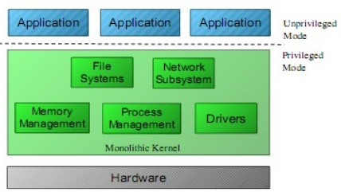
Monolithic Kernel

Slide 7
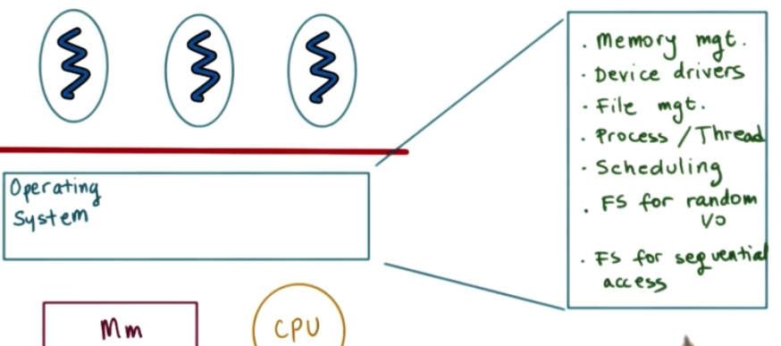
Monolithic Kernel

Slide 8
Monolithic Kernel
Pros:
More direct access to hardware for programs
Easier for processes to communicate between each other
If your device is supported, it should work with no additional installations
Processes react faster because there isn’t a queue for processor time.
Cons:
Large install footprint
Large memory is needed
Less secure because everything runs in supervisor mode

Slide 9
MicroKernel
In a Microkernel architecture, the core functionality is isolated from system services and device drivers.
This architecture allows some basic services like device driver management, file system etc. to run in user space.
This reduces the kernel code size and also increases the security and stability of OS as we have minimum code running in kernel.
Examples of operating systems that use a microkernel are - QNX, Integrity, PikeOS, Symbian, L4Linux, Singularity, K42, Mac OS X, HURD, Minix, and Coyotos.

Slide 10
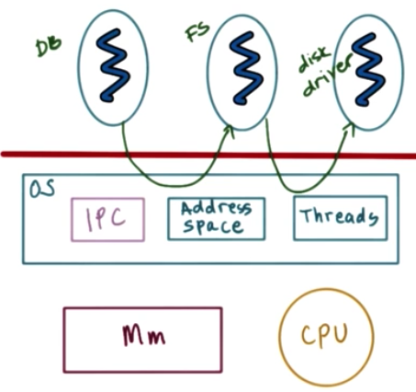
MicroKernel

Slide 11
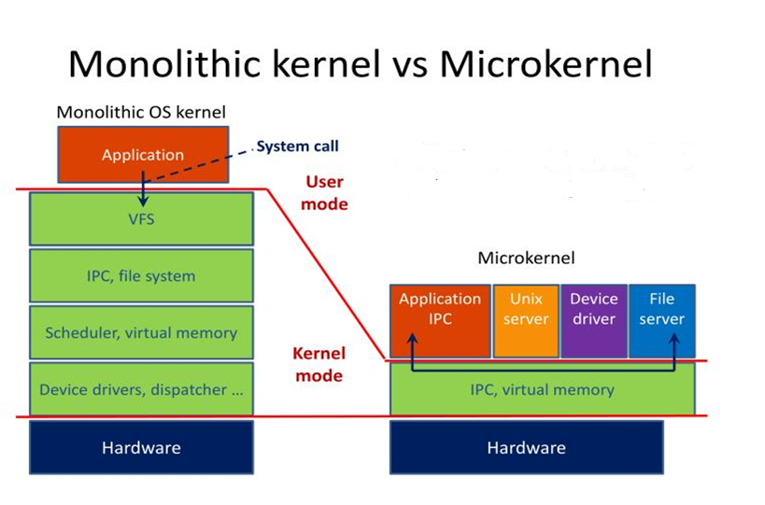
Types of Kernel

Slide 12
MicroKernel
Pros
Portability
Small install footprint
Small memory
Security
Cons
Hardware is more abstracted through drivers
Hardware may react slower because drivers are in user mode
Processes have to wait in a queue to get information
Processes can’t get access to other processes without waiting

Slide 13
Interrupts
An interrupt is a signal from a device attached to a computer or from a program within the computer that causes the main program that operates the computer (the operating system) to stop and figure out what to do next.
Interrupts can be of following type:
  Generated by Hardware (Hardware Interrupt)
  Generated by Software (Software Interrupt)

Slide 14
Hardware Interrupt
Hardware interrupts are used by devices to communicate that they require attention from the operating system.
Hardware interrupts by sending signal to CPU via system bus.
Hardware interrupts are referenced by an interrupt number.
These numbers are mapped with hardware that created the interrupt. This enables the system to monitor/understand which device created the interrupt and when it occurred.

Slide 15
Software Interrupt/ Trap
Interrupt generated by executing a instruction.
Software interrupts by a special operation called a System Call or Monitor Call.
Exp: 1. cout in C++ is a kind of interrupt because it would make a system to print something.
2. division by zero

Slide 16
Basic steps when interrupt occurs:
1. Interrupt Occurred?
2. H/w Transfers control to OS
3. OS preserves current state of process by using Registers and Program counter
4. Determine which kind of interrupt has occurred and Provides resources
5. When interrupt is executed, address is loaded to program counter and interrupted services are resumed.

Slide 17
I/O Interrupt
Once the I/O is started, 2 kind of interrupts may arise:
Synchronous interrupt (I/O): The control is transferred to the user process when I/O completes.
Asynchronous interrupt (I/O): Returns control to user process without waiting for I/O to complete.

Slide 18
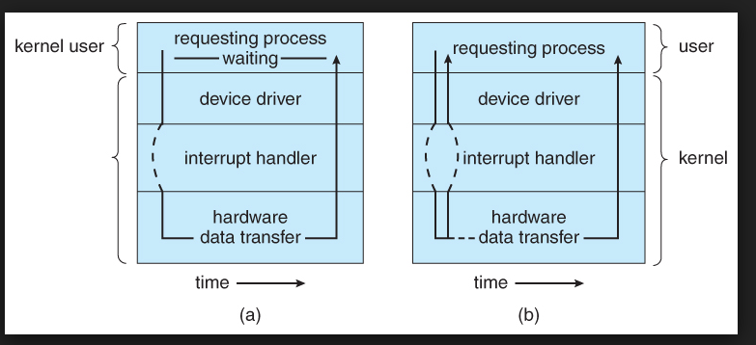
(a) Synchronous (b) Asynchronous

Slide 19
Waiting of I/O may be accomplished in 2 ways:
Wait: it let the CPU wait till the next interrupt.
Loop: Loop continues until interrupt is active.

Slide 20
Device Status Table
To keep the track of how many I/O requests are pending
Device Status Table is maintained.
  Device type
  Address
  State (idle,busy)

Slide 21
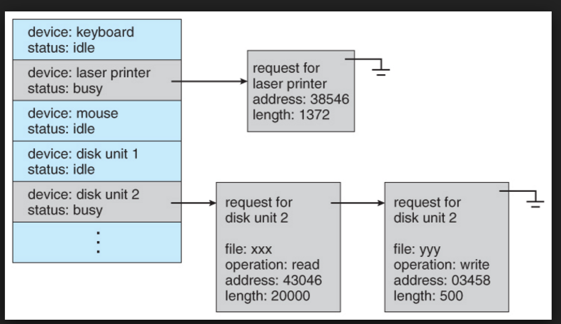

Slide 22
System Calls
Allow user-level processes to request services of the operating system.
It provides a way in which program talks to the operating system.
Why system calls are required?
It is a request to the operating system to perform some activity.
It is a call to the kernel in order to execute a specific function that controls a device or executes a instruction.
A system call looks like a procedure call

Slide 23
Accessing System Calls
System calls are accessed by programs via a high-level Application Program Interface (API) (provides run time environment)
System calls are implemented via API, API’s interact with kernel of OS.

Slide 24

Example of System Calls
System call sequence to copy the contents of one file to another file

Slide 25
System Call Implementation
A number is associated with each system call
  System-call interface maintains a table indexed according to these numbers
The system call interface invokes intended system call in OS kernel and returns status of the system call with a return value.
The caller needs to know nothing about how the system call is implemented
  Just needs to obey API and understand what OS will do as a result call
  Most details of OS interface hidden from programmer by API

Slide 26

API – System Call – OS Relationship

Slide 27

Standard C Library Example
C program invoking printf() library call, which calls write() system call

Slide 28
System Call Dispatch
Kernel assigns system call number to each system number
Kernel initializes system call table, mapping system call number to functions implementing the system call
User process sets up system call number and arguments
User process runs

Slide 29
System Call Dispatch
5. Hardware switches to kernel mode and calls kernel’s interrupt handler for user process (interrupt dispatch)
6. Kernel looks up syscall table using system call number
7. Kernel calls/invokes the corresponding function
8. Kernel returns by running interrupt return and processing the actual program.

Slide 30
System Call Parameter Passing
Passing Parameters to System Calls:
Information required for a system call vary according to OS and call.
Three general methods used to pass parameters to the OS
  1. Pass the parameters in registers
    When parameters are < 6.
  2. Parameters stored in a block, or table, in memory, and address of block passed as a parameter in a register. (6 or more)
    This approach taken by Linux and Solaris
  3. Parameters placed, or pushed, onto the stack by the program and popped off the stack by the operating system.

Slide 31

Parameter Passing via Table

Slide 32
Types of System Calls
5 Categories
Process Control
  end, abort
  load, execute
  create process, terminate process
  get process attributes, set process attributes
  wait for time
  wait event, signal event
  allocate and free memory
File Management
  create file, delete file
  open, close file
  read, write, reposition
  get and set file attributes

Slide 33
Types of System Calls (Cont.)
Device Management
  request device, release device
  read, write, reposition
  get device attributes, set device attributes
  logically attach or detach devices
Information Maintenance
  get time or date, set time or date
  get system data, set system data
  get and set process, file, or device attributes
Communications
  create, delete communication connection
  send, receive messages
  transfer status information
  attach and detach remote devices

Slide 34
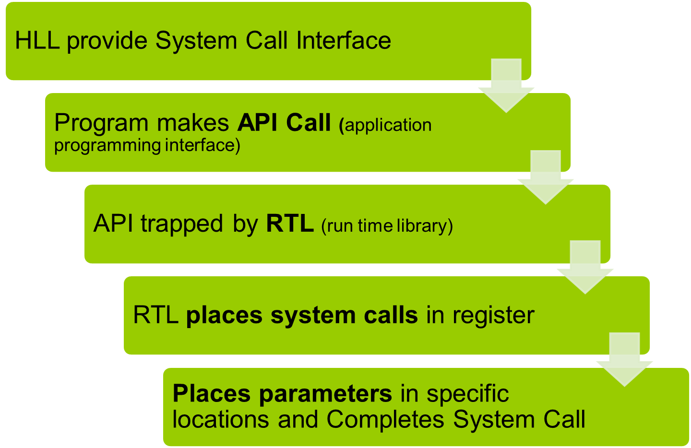
System Call Implementation

Slide 35
Q1. Who controls the execution of programs to prevent errors and improper use of computer?
a) Resource allocator
b) Control Program
c) Hardware
d) None of the above

Slide 36
Q2. The operating system switches from user mode to kernel mode so the mode bit will change from?
a) 0 to 1
b) 1 to 0
c) Remain constant
d) None

Slide 37
Q3. In which type of operating system users do not interact directly with the computer system?
a) Multiprogramming operating systems
b) Multiprocessing operating systems
c) Batch operating systems
d) Distributed operating systems

Slide 38
Ans 3) c

Slide 39
Q4. What is the objective of multiprogramming operating systems?
a) Maximize CPU utilization
b) Switch the CPU among processes
c) Achieve multitasking
d) None of the above

Slide 40
Ans4. a)

Slide 41
Q5. Who signalled for the occurrence of an event either from the hardware or the software?
a) Bootstrap program
b) Interrupt
c) Disk Controller
d) CPU

Slide 42
Ans5: b

Slide 43
Q6. In which type of I/O interrupts the control return to the user program after the completion of I/O operation?
a) Synchronous I/O interrupts
b) Asynchronous I/O interrupts
c) System Call
d) Hardware

Slide 44
Ans 6) a

Slide 45
Q7: The device-status table contains
a) each I/O device type
b) each I/O device state
c) each I/O device address
d) all of the above
(d)

Slide 46
Ans 7 (d)

Slide 47

Storage Structure and Hierarchy

